Slide 1
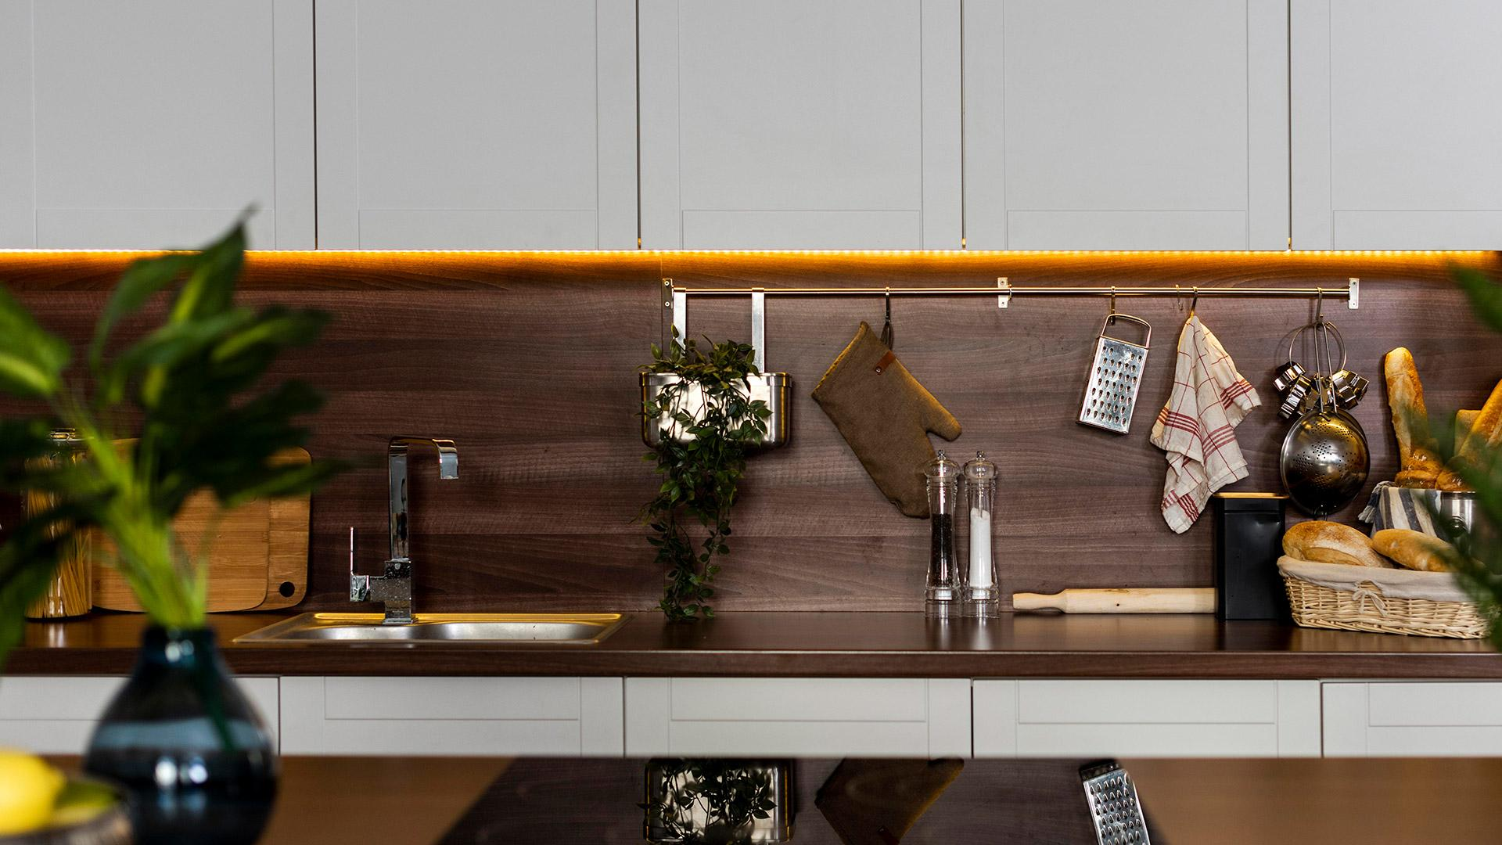
Enchulame The Kitchen
German E. Baltazar Reyes

Slide 2
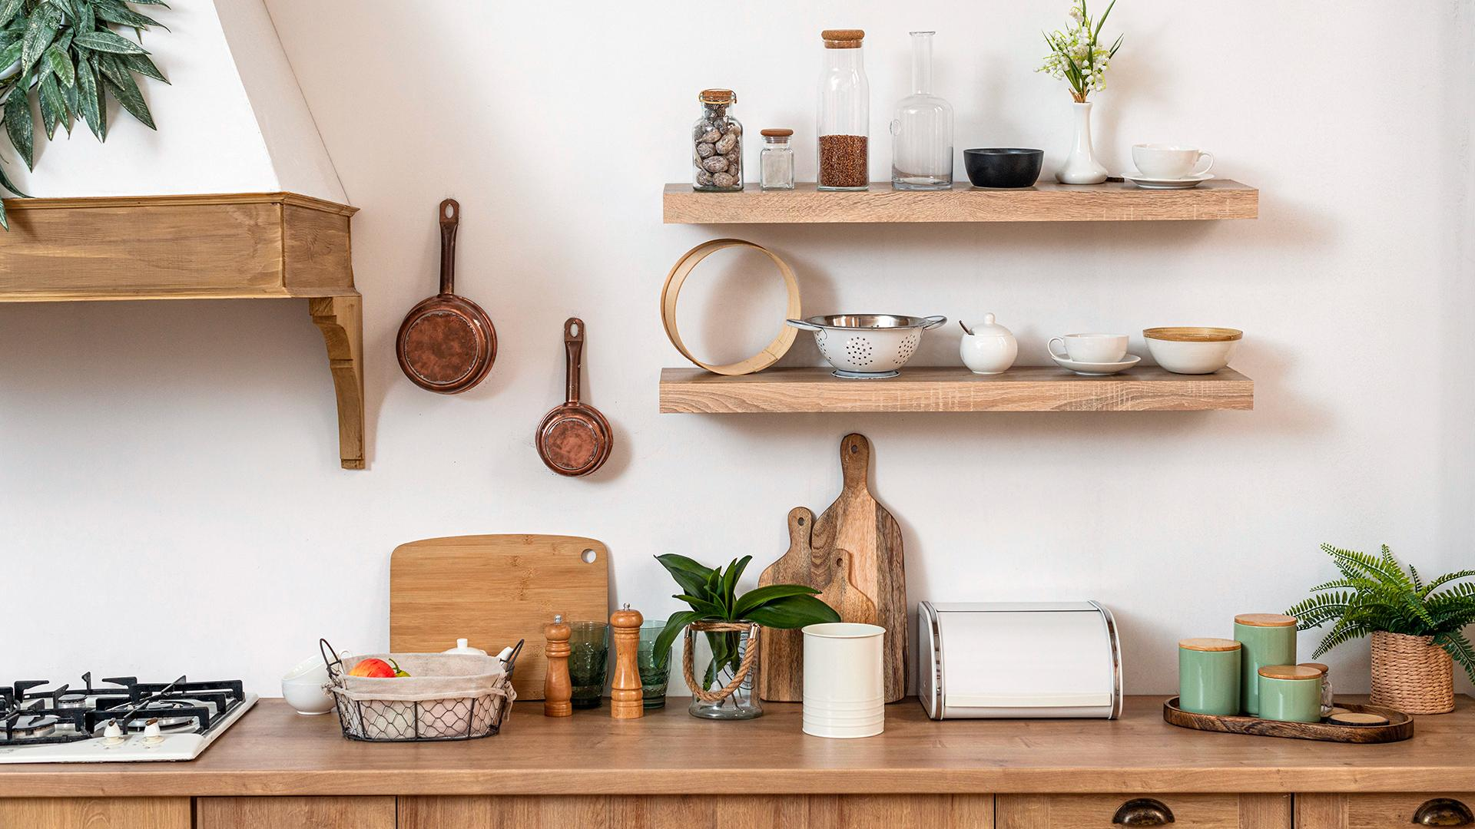
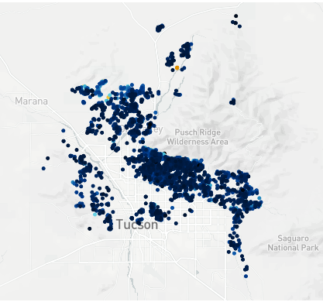
About us
We’re a company focused on redecorating your kitchen based on the elements it already has.
Currently working on Tucson, Arizona
3,784 clients on the region

Slide 3
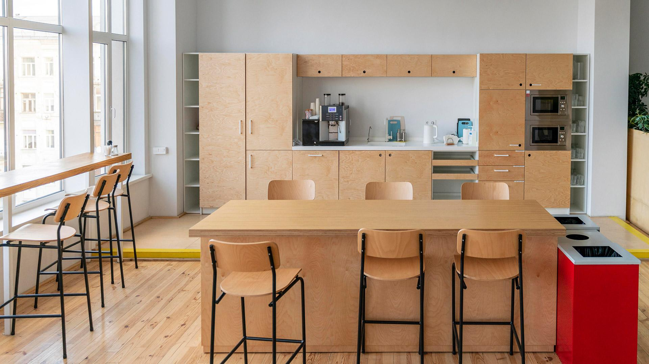


















Check our products
You can select between our 20 different products.
Electric, convection and gas ovens
Wet bars
Appliance color
Compactors
Garbage disposals
Lazy Susan
Refrigerators
Freezers
Microwaves
Dishwashers
Pantries
Water purifiers
Countertops
Desks
Sinks
Indoor grills
Warming drawers
Wine coolers

Slide 4
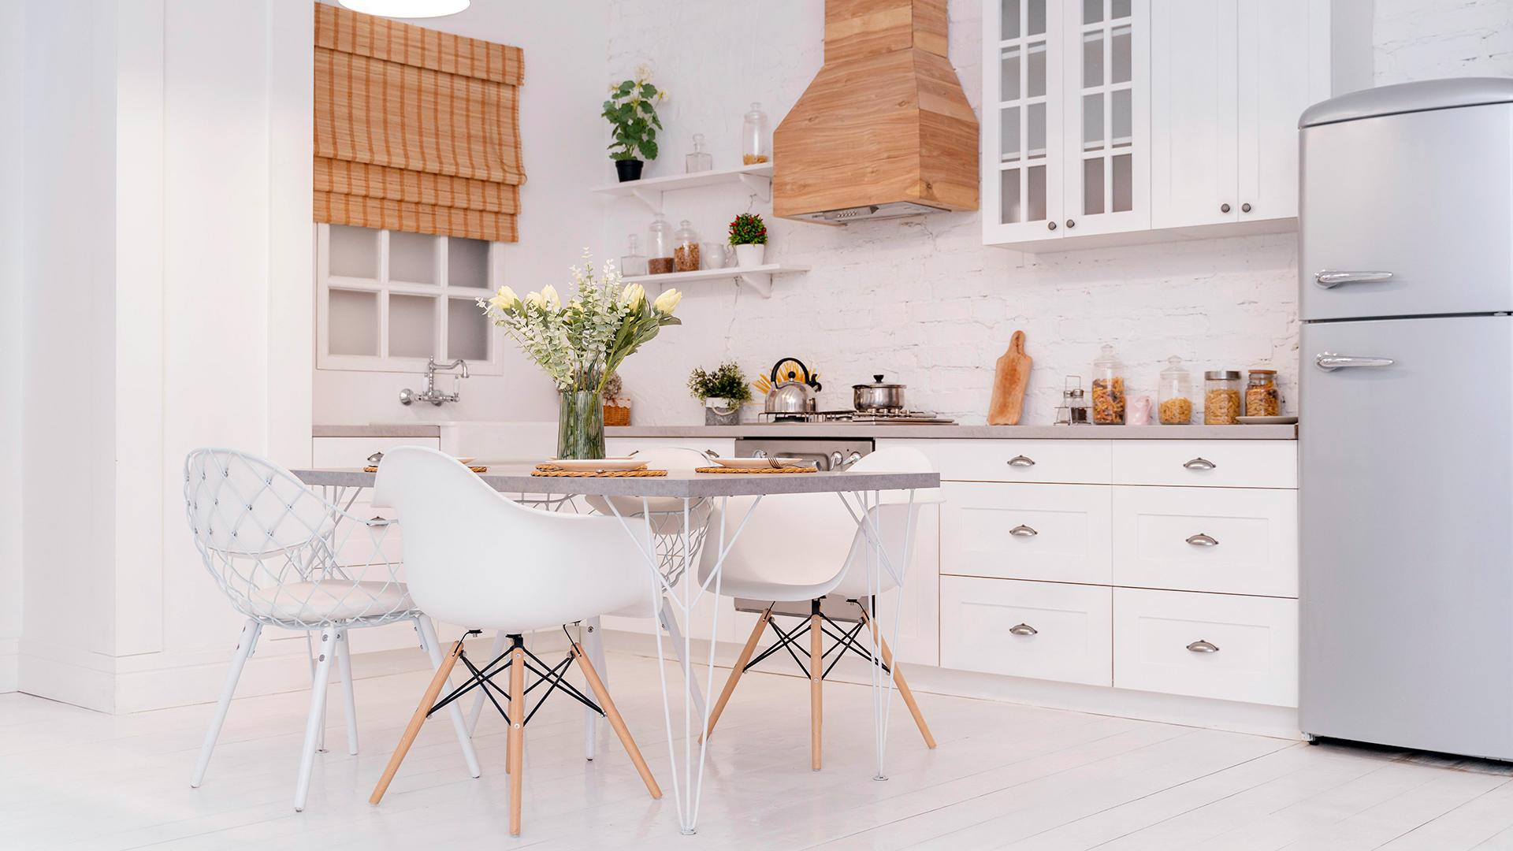




How does it work?
Wait for our response
Fill your file
Select a product
Enchula your kitchen
Tell us what you already have on your kitchen
See if your kitchen is eligible for the remodeling immediately!
Select the product you’d like to enchular your kitchen with
Visit our stores to select the best model to enchular your kitchen

Slide 5
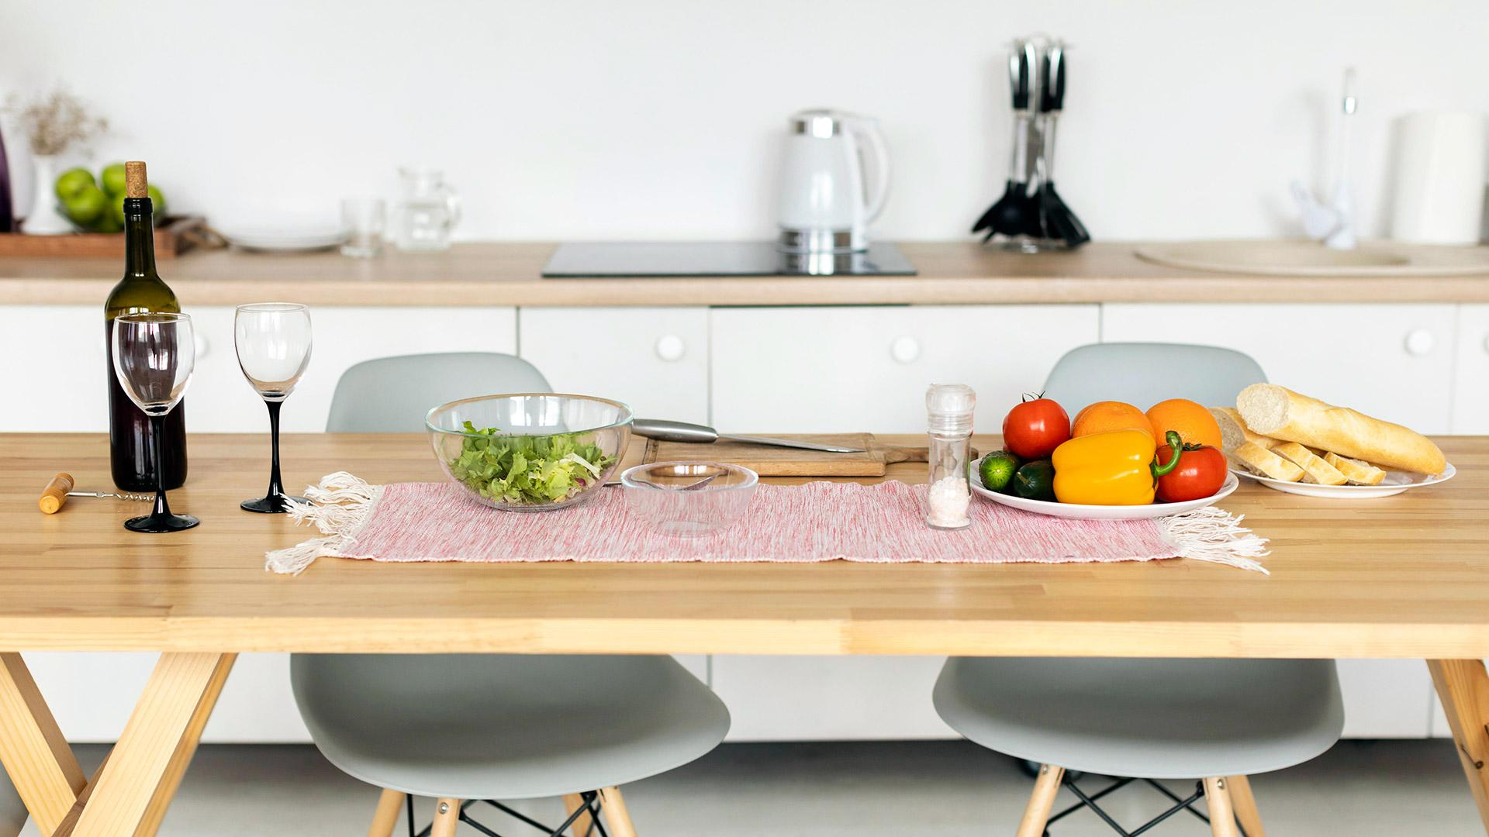

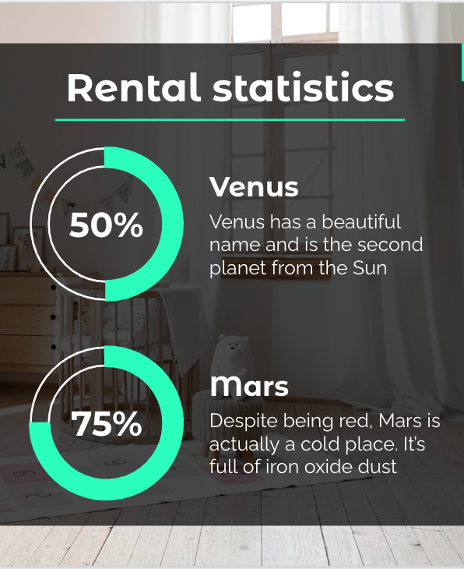
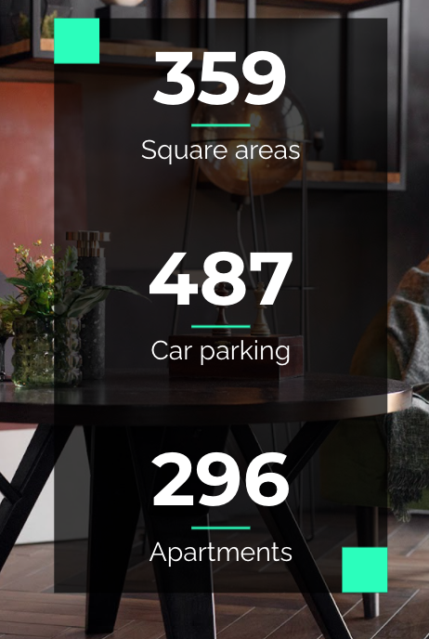
Best service guaranteed
Our AI algorithms tells you how feasible the remodeling is with a 93.39% accuracy!

Slide 6
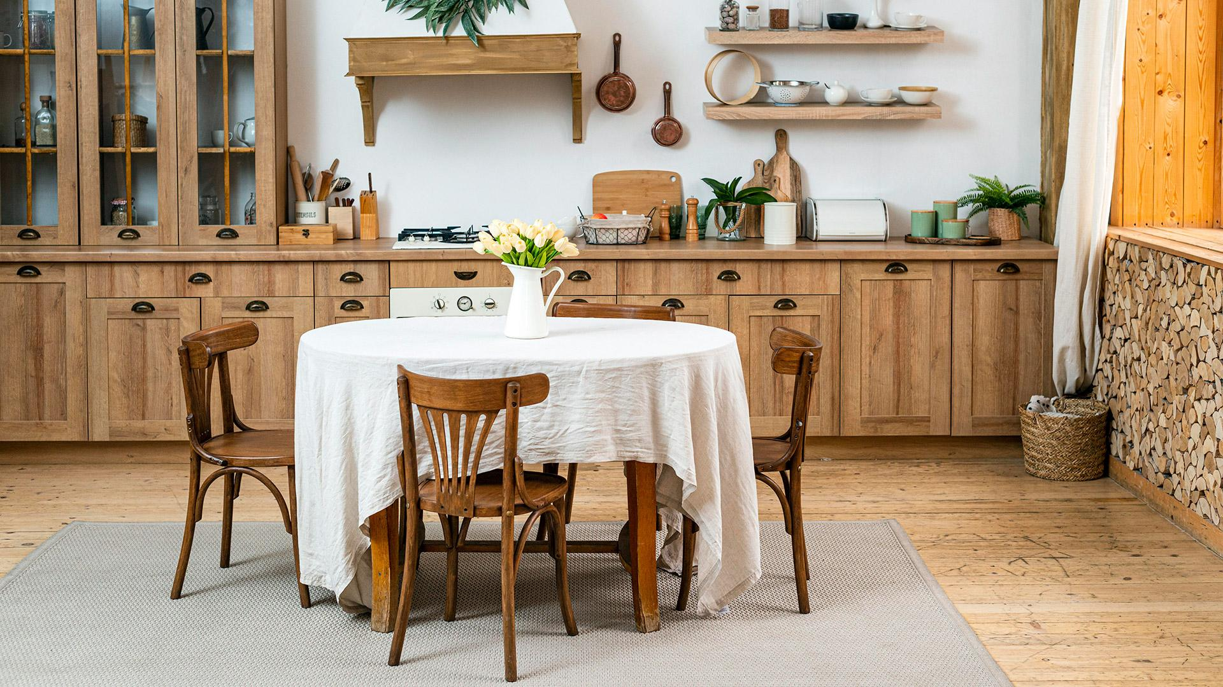
Always improving
Enchulame my floor | Select from multiple tiles to match your floor with your kitchen
House value analysis | We’ll tell you how much your house will cost after redecorating
Enchulando the US | Broader area, enchulando houses all around the country
Keep in touch to know about our future implementations!

Slide 7
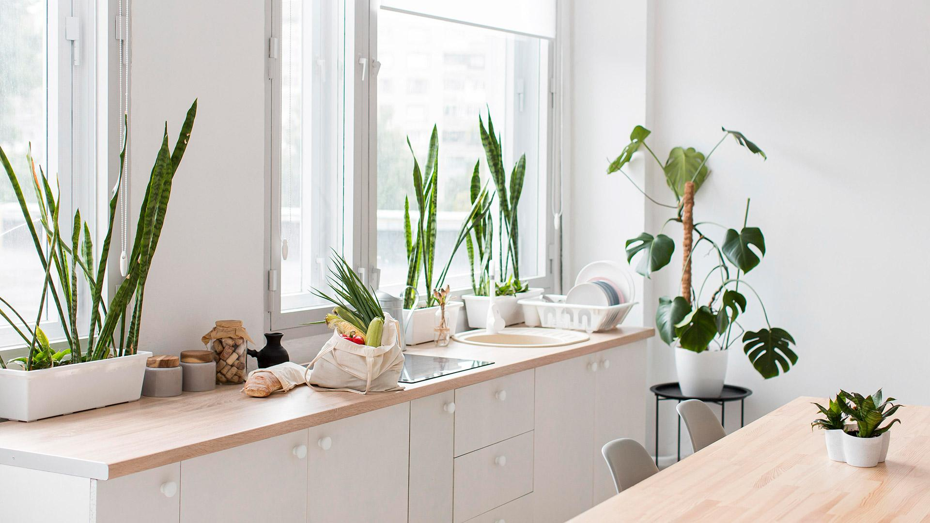
In conclusion
We’re the best option for redecorating your house
Free evaluation
No need for a contractor
Fast and accurate evaluation
Multiple products to select
Designed for the regular home-owner

Slide 8
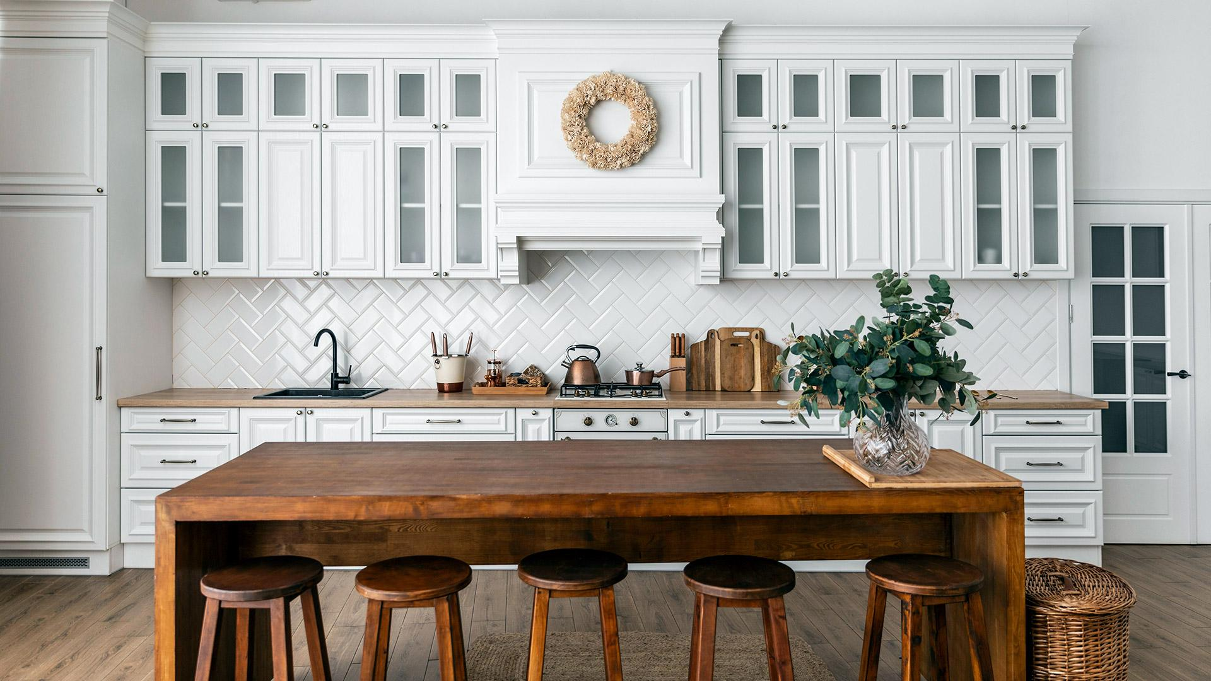
Any Questions?
Thanks for your attention
Live demo available

Slide 9

Appendix
Original dataset distribution 10
Latitude tuning 11
Longitude tuning 12
Data mapping 13
Categorical data encoding 14
Kitchen_features encoding 15
Floor_covering encoding 16
Correlation matrix 17
Kitchen_features linearity analysis 18
Model hyperparameters 28
Linear regression analysis 30
Model training 31

Slide 10
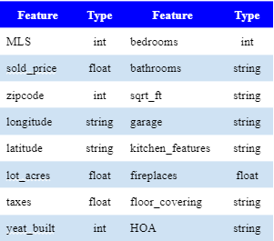
Original Dataset
5,000 observations
35 observations with null values
Outliers outside Tucson area
Only worked with sold_price, longitude, latitude, sqrt_ft, kitchen_features, floor_covering

Slide 11
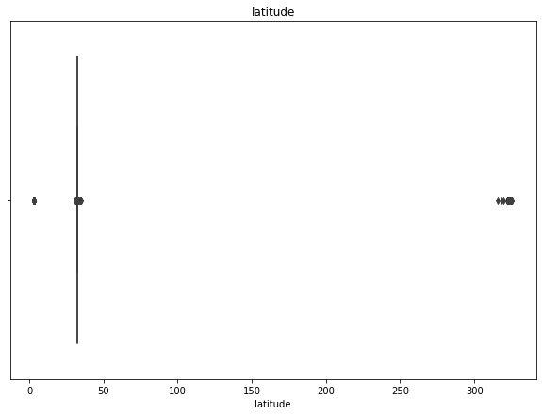
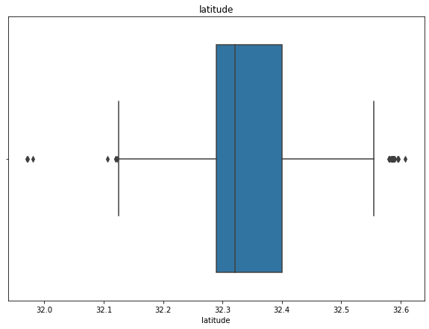
Latitude tuning
Removed rightmost dot and joined values
Parsed from string to float
Delimited the area 31.97 < latitude < 32.7

Slide 12
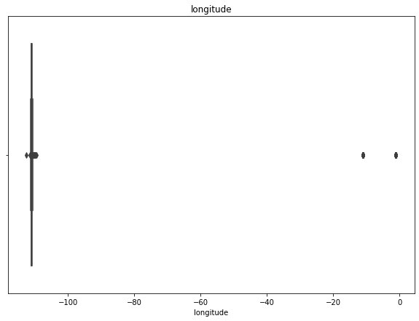
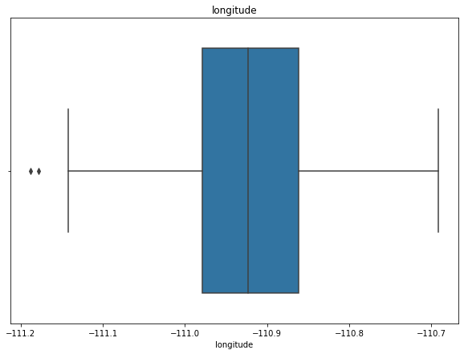
Latitude tuning
Removed rightmost dot and joined values
Parsed from string to float
Delimited the area -111.19 < longitude < -110.69

Slide 13
Data mapping
3,784 observations

Slide 14
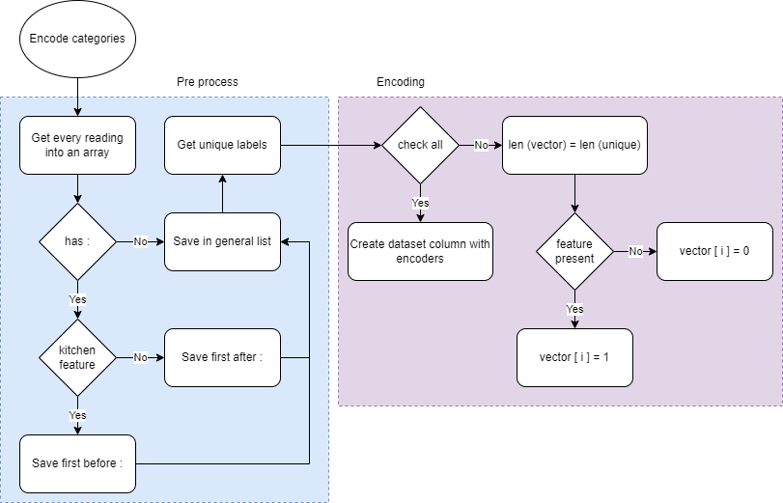
Categorical data encoding

Slide 15

Kitchen_features encoding
Appliance color
Black
Stainless
Countertops
Butch block
Island
Quartzite
Microwave
Electric oven
Electric
Electric range
Convection oven
Oven
# of ovens
Convection
Gas oven
Gas range
Gas cooktop
Compactor
8. Desk
9. Dishwasher
10. Sink
Prep sink
Double sink
11. Freezer
12. Garbage disposal
13. Pantry
14. Indoor grill
15. Lazy Susan
16. Refrigerator
17. Water purifier
a. Reverse purifier
18. Warming drawer
19. Wet bar
20. Wine cooler

Slide 16

Floor_covering encoding
Mexican
Talavera
Porcelain
100% porcelain tile
Italian
Porcelain wood
Porclain
Stone
Natural stone
Cantera
Acrylic
Acrylic overlay
Wood
Bamboo
Brazilian pergo
Brick
Carpet
8. Ceramic
9. Concrete
10. Vinyl
11. Marble
12. Other

Slide 17
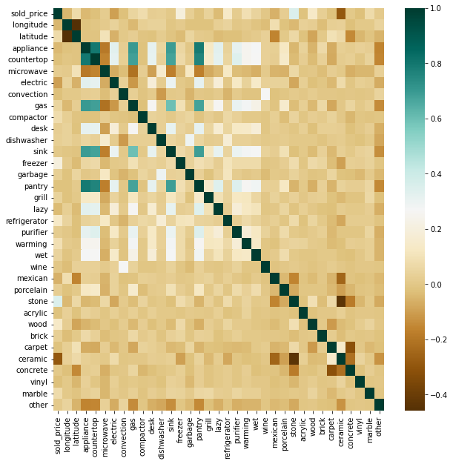
Correlation matrix

Slide 18
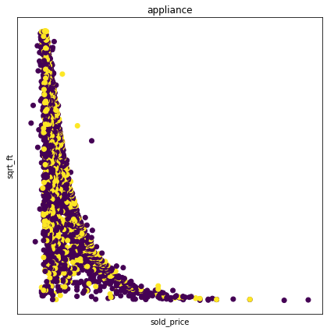

Linearity analysis

Slide 19
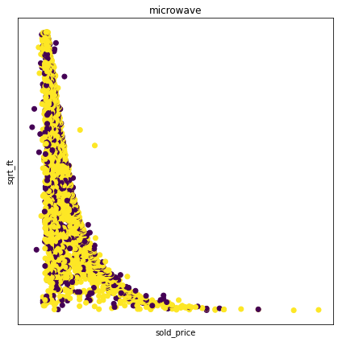
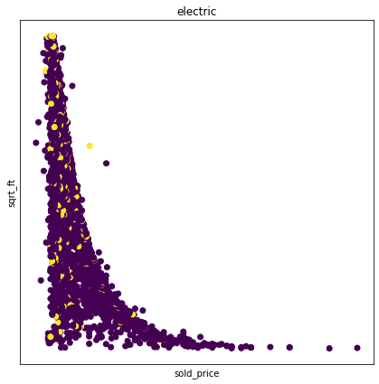
Linearity analysis

Slide 20

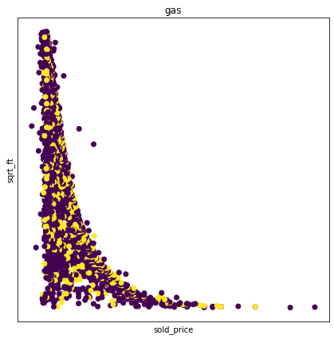
Linearity analysis

Slide 21

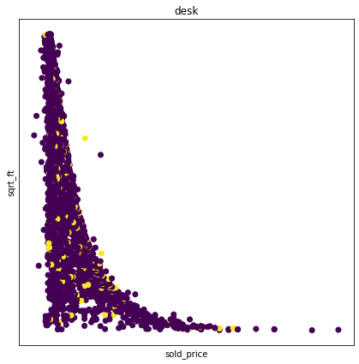
Linearity analysis

Slide 22
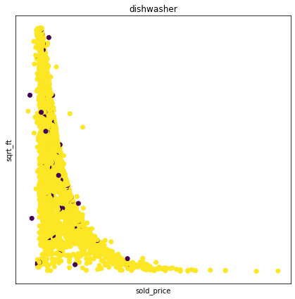
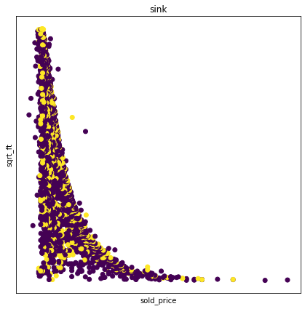
Linearity analysis

Slide 23

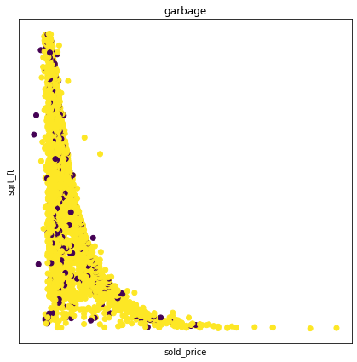
Linearity analysis

Slide 24
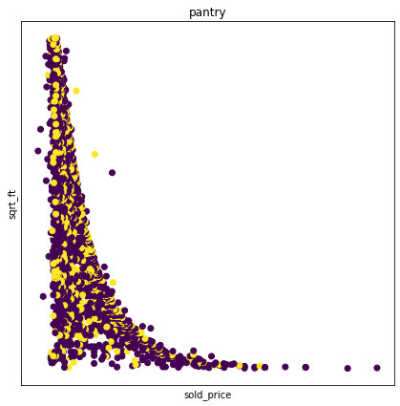

Linearity analysis

Slide 25

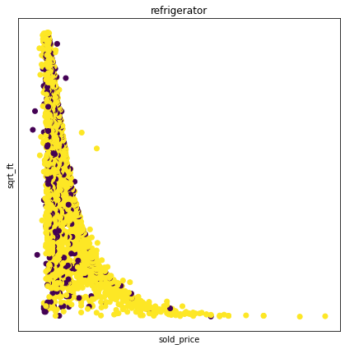
Linearity analysis

Slide 26


Linearity analysis

Slide 27


Linearity analysis

Slide 28
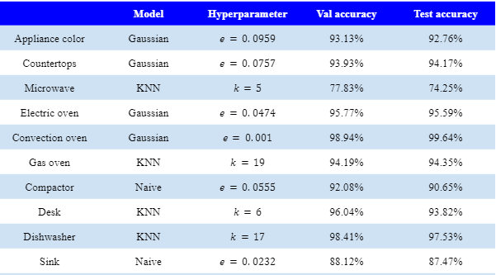
Model hyperparameters

Slide 29
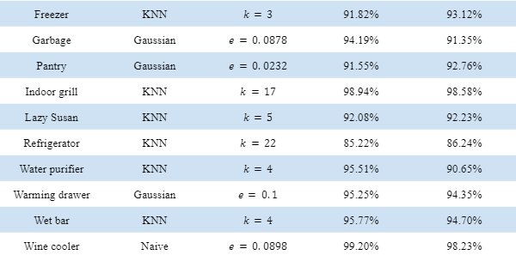
Model hyperparameters

Slide 30
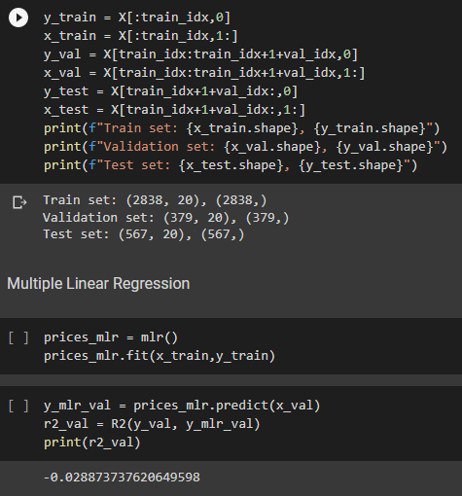
Linear regression analysis

Slide 31
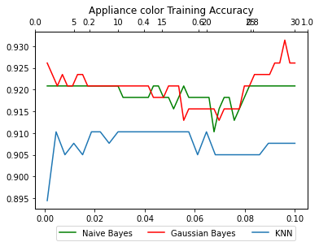
Model training

Slide 32
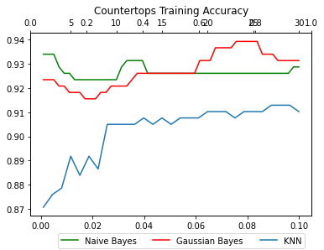
Model training

Slide 33
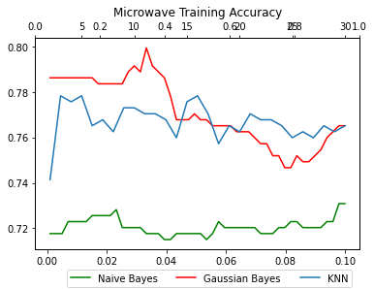
Model training

Slide 34
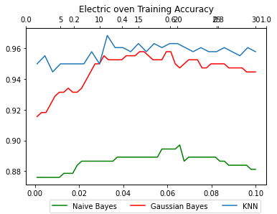
Model training

Slide 35
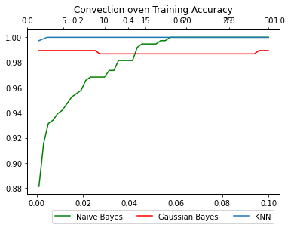
Model training

Slide 36
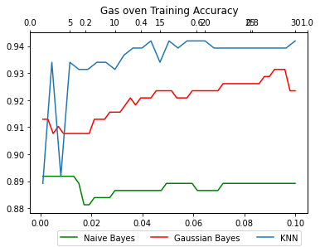
Model training

Slide 37
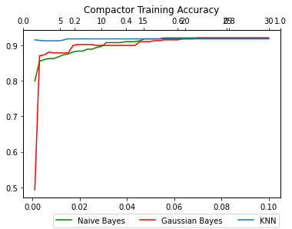
Model training

Slide 38
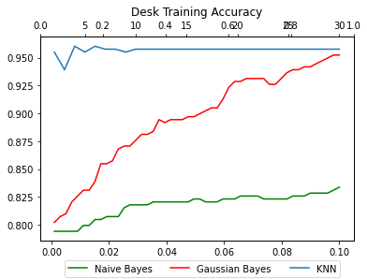
Model training

Slide 39
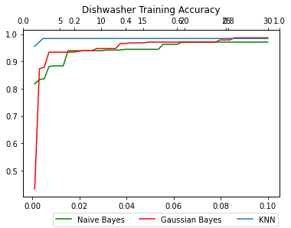
Model training

Slide 40
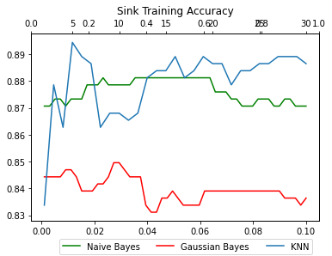
Model training

Slide 41
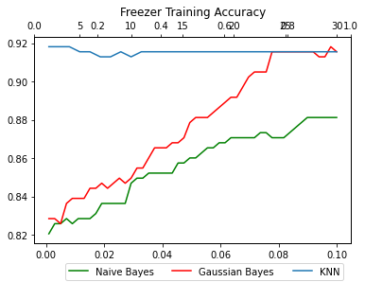
Model training

Slide 42
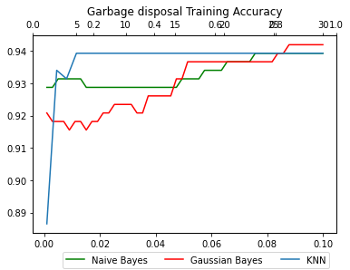
Model training

Slide 43
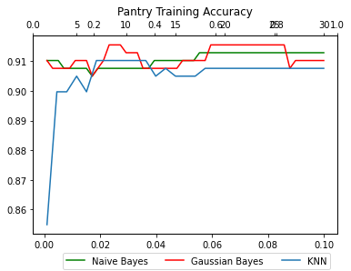
Model training

Slide 44
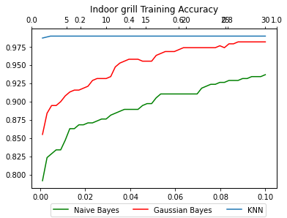
Model training

Slide 45
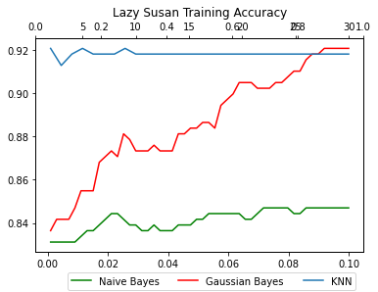
Model training

Slide 46
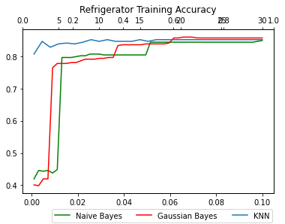
Model training

Slide 47
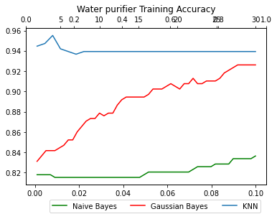
Model training

Slide 48
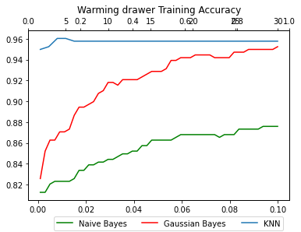
Model training

Slide 49
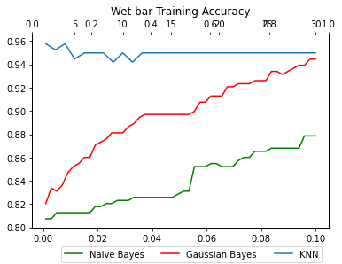
Model training

Slide 50

Model training

